Slide 1

Youth Problem Gambling
By Adriel Willis

Slide 2


ABOUT THE ISSUE
Today, we're tackling a significant issue: adolescent gambling. With the explosion of online gaming and the inclusion of gambling elements in video games, young people are increasingly drawn into risky behavior that can lead to addiction. We're seeing a cycle where they get hooked without even recognizing the dangers. It's crucial for us to step up and implement regulations to protect them and prevent these harmful habits from taking hold. This is a serious problem that demands our immediate attention.

Slide 3
01
18
24
33
1st Perspective
Perspective in Favor of Strict Regulations
Focus on the need for comprehensive regulatory measures and proactive strategies.
Emphasizes potential harm of gambling on young people, including addiction, financial loss, and negative social consequences.
Increased risk of developing gambling addiction, which can have long-lasting consequences on mental health and well-being.
Elevated risk of engaging in other risky behaviors, such as substance abuse and delinquency, due to association with gambling environments.
Strained relationships with family and peers, as gambling addiction can lead to deception, loss of trust, and social isolation.
Long-term implications for future employment and career prospects, as gambling addiction can interfere with job stability and performance.
32
64
44
68
58
45
10
17

Slide 4


2 Perspective
EASY PICK
Perspective Against Strict Regulations
Courts may argue that because players receive in-game items of value, these practices don't meet the legal definition of gambling.
Supporters argue that not all chance-based gaming mechanics pose the same level of risk as traditional gambling.
They suggest labeling such practices as gambling could lead to unnecessary regulation and limit player enjoyment.
Legal interpretations may vary depending on jurisdiction and evolving understandings of gambling-related issues.
Despite not meeting the legal definition of gambling, concerns about negative impacts on young people's well-being warrant attention.

Slide 5
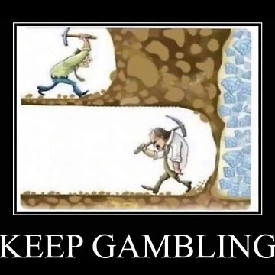
3rd Perspective
Perspective On It's Already Illegal
Views youth gambling as a manifestation of a broader societal problem.
Considers the prevalence of underage gambling as a failure of regulatory and legal mechanisms to adequately address the issue.
Argues that the persistence of youth gambling despite existing regulations indicates systemic weaknesses in enforcement and oversight.
Highlights the need for more stringent enforcement of existing laws and regulations to combat illegal gambling activities targeting young people.
Advocates for increased collaboration between law enforcement agencies, regulatory bodies, and community stakeholders to identify and prosecute perpetrators of illegal gambling operations.
Emphasizes the importance of public awareness campaigns to educate young people about the risks and consequences of illegal gambling and to promote alternative recreational activities.

Slide 6

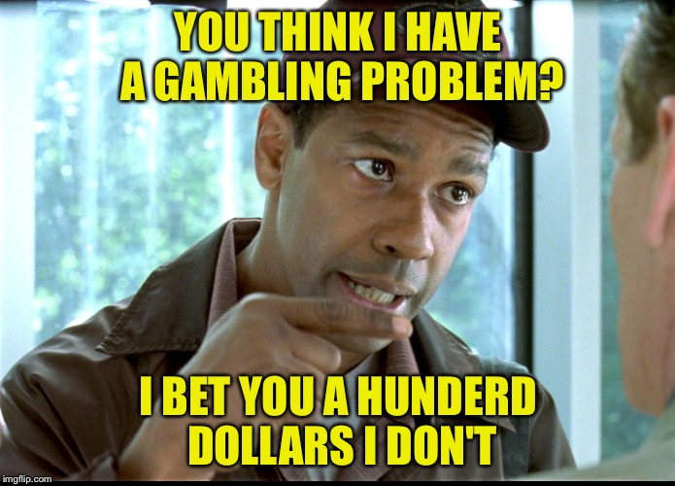
Solution
EASY FIX?
Solutions to Address Youth Gambling
Proposes stricter age verification measures on online gambling platforms
Advocates for the implementation of mandatory warnings and age restrictions on video games containing gambling elements, ensuring they are clearly labeled and inaccessible to minors.
Gambling education programs into school curricula, covering topics such as risk awareness, decision-making skills, and coping strategies to resist gambling temptations.
Specialized treatment centers for youth gambling addiction Calls for increased funding for research on youth gambling behavior and its underlying causes
Encourages partnerships between government agencies, community organizations, and the gaming industry to fund and implement youth-focused initiatives
Recognizes the influence of parental gambling behavior on youth and the need to address it as part of comprehensive prevention efforts.

Slide 7
THANK YOU
Any Question?

